Slide 1
Cognitive Modeling Lecture 2 Time Estimation

Slide 2
Assignment last week
Addition instead of counting

Slide 3
Interval timing is the capacity to estimate the duration of (short) intervals

Slide 4
Why bother with time?
Timing is automatic, and implicit.
Timing is implicit in many tasks / settings
Language:
Using pauses as a rhetorical tool.
Turn-taking in conversation.
Human-Environment Interaction:
Adapting to the pace of the environment
Psychological Experiments

Slide 5
Temporal Decision making

Slide 6



Slide 10
Red or Green
longer?

Slide 11
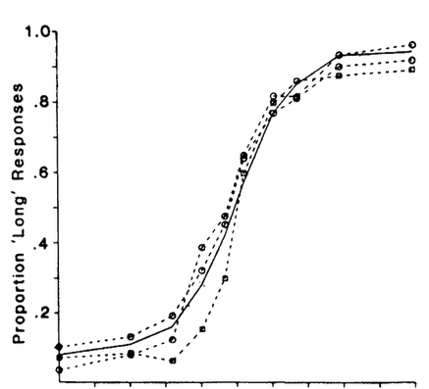
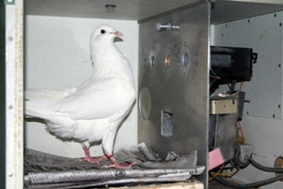
P(“Red longer”)
http://www.uky.edu/~zentall/recentpublication.html
Green longer
Equal
Red longer
Adapted from Heinemann (1984) Annals NY Academy of Sciences

Slide 12
Ready-Set-Go

Slide 13
Notes:
Temporal generalization

Slide 20
Reproduction

Slide 26
Correct!
Too fast!
Too slow!

Slide 27
Results: Scalar Property

Slide 28
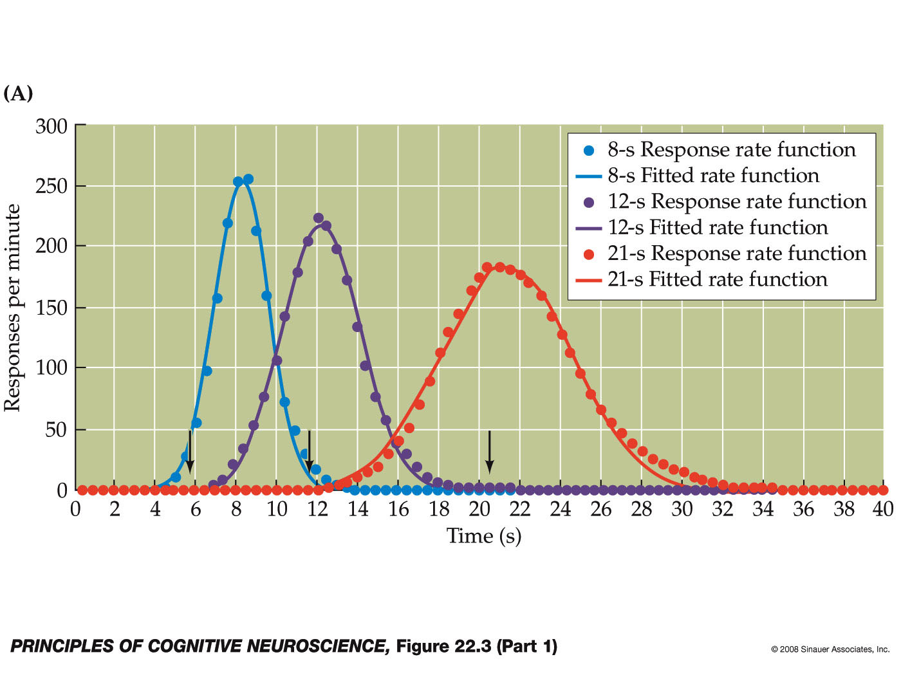
Peak Procedure

Slide 29
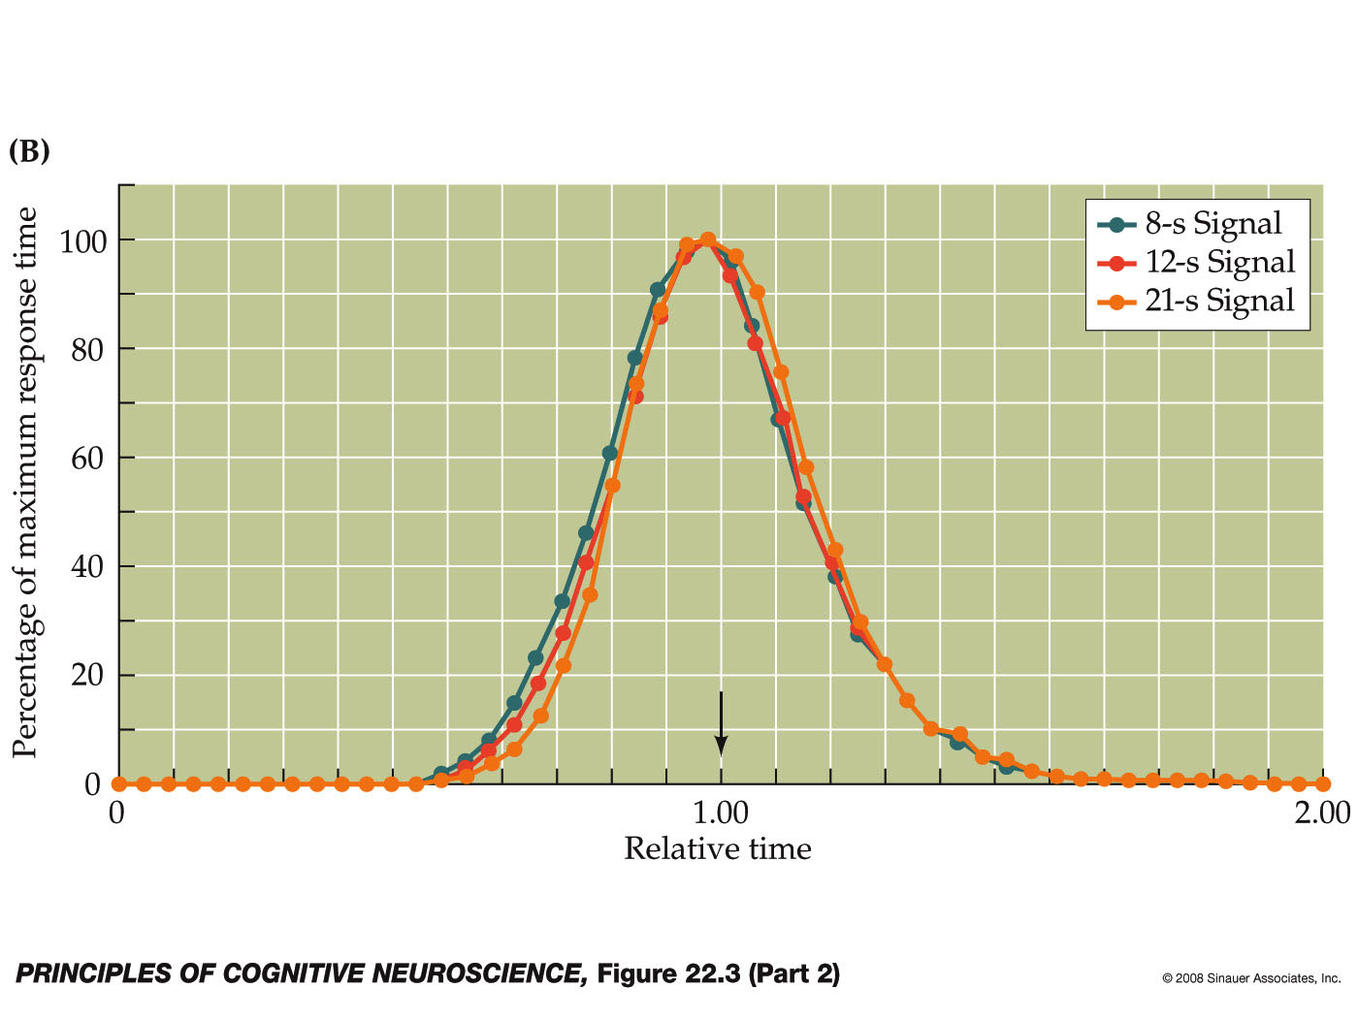
Scalar Property

Slide 30
What drives interval timing?

Slide 31
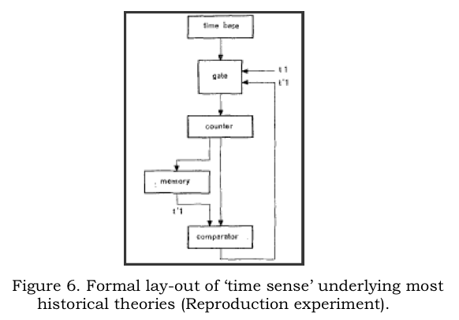
Information Processing Approaches to Interval Timing
(e.g., Creelman, 1962, Michon, 1967, Gibbon, 1977, Treisman, 1963)
Notes:
Temporal behavioral requires more than “just time”, it has to be embedded in a broader cognitive system.
“Modified church and gibbon model”

Slide 32
IP Models of Interval Timing
(e.g., Creelman, 1962, Michon, 1967, Gibbon, 1977, Treisman, 1963, etc)

Slide 33
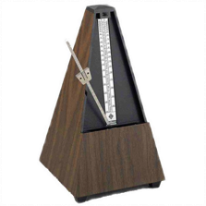
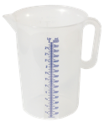

Scalar Timing Theory

Slide 34

Scalar Timing Theory
2
4
1
3
Notes:
Red or green (left or right) longer on the screen?

Slide 35
Scalar Timing Theory
2
1
3
4
Notes:
It could be, of course, that instead of a perfect match, an “close match” would have been sufficient to trigger the “same” response.

Slide 36
Scalar Timing Theory
3
4
Green or Red?
Red
Notes:
It could be, of course, that instead of a perfect match, an “close match” would have been sufficient to trigger the “same” response. But what determines whether a match is “close”? Well, these types of models don’t provide us with an answer…

Slide 37
IP Models of Interval Timing
Notes:
It could be, of course, that instead of a perfect match, an “close match” would have been sufficient to trigger the “same” response. But what determines whether a match is “close”? Well, these types of models don’t provide us with an answer…

Slide 38
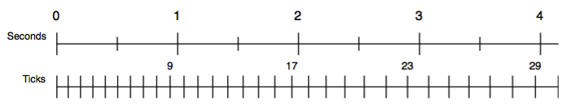
Timing Module
Idea: Metronome that starts ticking fast, but gradually slows down
The current value of the accumulator is available to the rest of cognition
At any moment, the accumulator can be read or matched in the condition of a production

Slide 39
Stochastic Process
t₀ = length of starting pulse
t_{n+1}= a x t_{n} + noise(M=0, SD=b x a x t_{n})
Noise = logistic noise (ACT-R default, normal-like)
Two sets of parameters:
t₀ = 11 ms, a = 1.1, b = 0.015 t₀ = 100 ms, a = 1.02, b = 0.015

Slide 40
Demo: Peak procedure

Slide 41
Limitations up to now
Simplistic memory theory

Slide 42
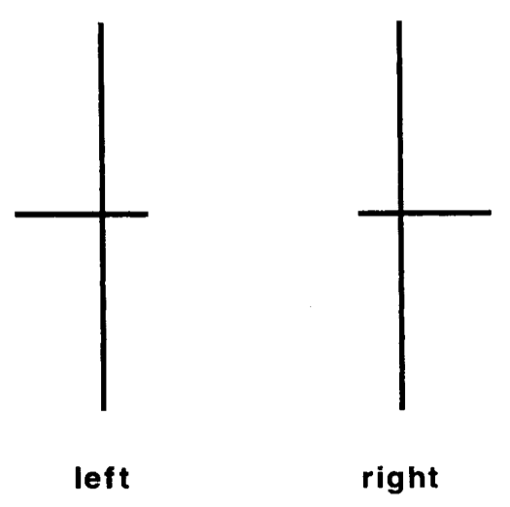
Assignment for this week
Grosjean, M., Rosenbaum, D. A., & Elsinger, C. (2001). Timing and reaction time. Journal of Experimental Psychology: General, 130(2), 256.
Experiment that looked at the “foreperiod”

Slide 43
Experimental manipulation
Time between the response and the next stimulus
For fifteen trials 350ms, 467ms or 700ms
On trial sixteen always 467ms

Slide 44
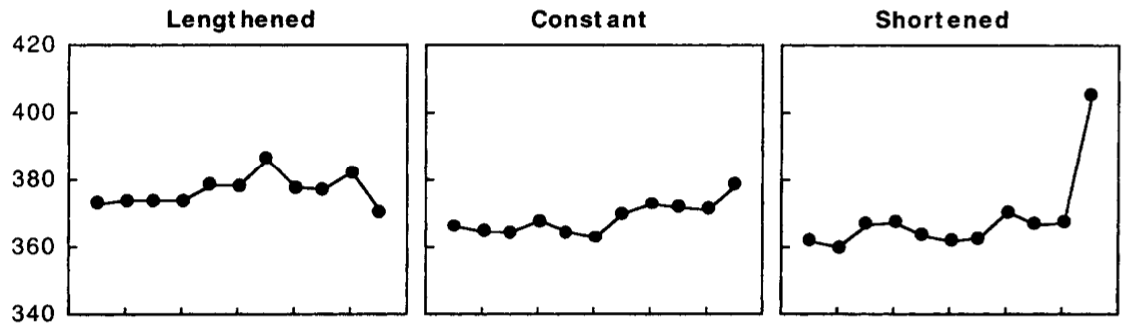
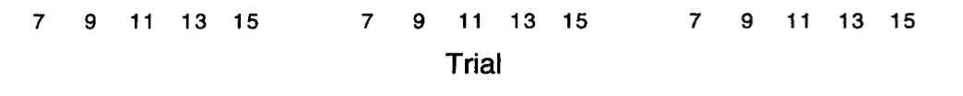
Results
350 - > 467 ms
467 - > 467 ms
700 - > 467 ms

Slide 45
Your task
Models this!
No ACT-R yet, just time perception functions
Assumption: being prepared gives a 50ms advantage

Slide 46
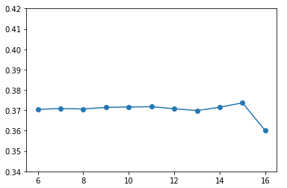
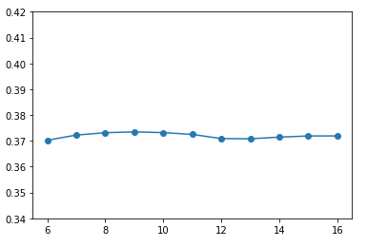
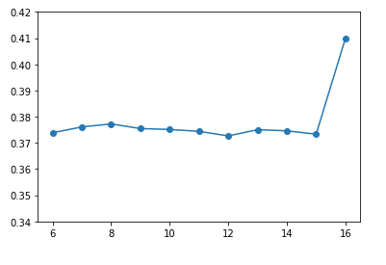
My best fit
350 - > 467 ms
467 - > 467 ms
700 - > 467 ms

Slide 47
Time estimation and Memory: Base-level learning
Two factors play a role in activation:
Frequency of use
Recency of use

Slide 48
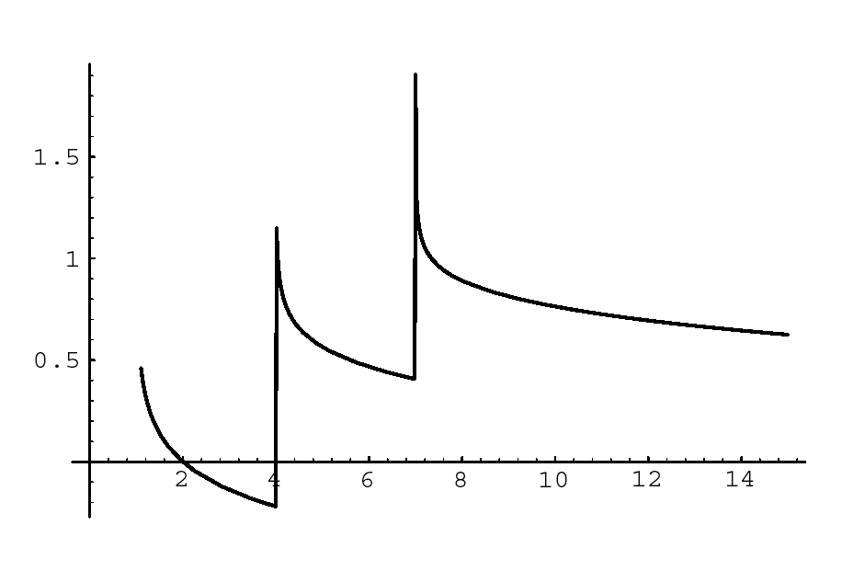
Example of Activation in time
Activation
Time

Slide 50
Activation determines
Forgetting (activation below a certain threshold means failure to retrieve)
Retrieval time (low activations means longer retrieval time)
Priority (chunk with highest activation will be selected)

Slide 51
Graph of retrieval time (F=1)
retrieval threshold

Slide 52
Instance-based learning
Simplest example: Alphabet Arithmetic
What is J+4?
Algorithm/Heuristic is counting
Learning the English past tense
Algorithm/Heuristic is regular rule

Slide 53
Flavors of IBL
What is the nature of the instances?
State/Actions with evaluations
Only “correct” State/Actions (As in 1-up BlackJack)
How are instances retrieved?
Regular retrieval
Partial matching
Blending

Slide 54
Dikes-and-Rivers experiment
Time estimation
In earlier work, we found that if subjects need to memorize two time intervals, these intervals start to ”contaminate” each other
The goal of this experiment is to investigate this contamination in more detail
Taatgen, N., & Rijn, H. (2011). Traces of times past: Representations of temporal intervals in memory. Memory & Cognition, 39(8), 1546–1560.

Slide 55
Experiment
Subjects alternate producing time intervals of a short and a long duration.
Initially, short is 2 seconds and long is 3.1 seconds
They receive feedback on whether their estimate is within +/- 12.5% of the target, and receive “too short” or “too long” as feedback otherwise.
After a number of trials, the criterion for the long interval starts to change.

Slide 56
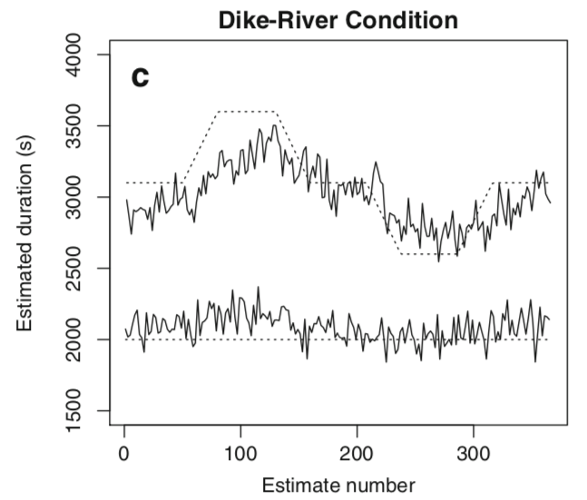
Results

Slide 57
Analysis: Linear Mixed-Effect models
Start with a simple regression equation:
short_{n,s} = β₀ + r_{s} + ε_{n,s}
Then add factors as long as the more complex equation fits the data significantly better than the previous model
short_{n,s} = β₀ + β₁short_{n-1,s} + β₂short_{n-2,s} + r_{s} + ε_{n,s}

Slide 58
Final set of factors for short interval
Fixed Effect | Value of β | t value
Intercept | 657 ms | 4.6
short_{n-1} | 0.385 | 8.3
short_{n-2} | 0.085 | 3.3
short-fb-S_{n-1} | 110 ms | 3.1
short-fb-L_{n-1} | -208 ms | -6.5
long_{n-1} | 0.16 | 5.1
long-fb-S_{n-1} | 92.6 ms | 3.2
long-fb-L_{n-1} | -163 ms | -4.2

Slide 59
For long interval
Fixed Effect | Value of β | t value
Intercept | 695 ms | 3.8
long_{n-1} | 0.34 | 8.5
long_{n-2} | 0.16 | 4.0
long_{n-3} | 0.12 | 4.6
long_{n-4} | 0.05 | 1.9
long-fb-S_{n-1} | 159 ms | 4.8
long-fb-L_{n-1} | -118 ms | -2.5
long-fb-S_{n-2} | 82.9 ms | 2.5
long-fb-L_{n-2} | 3.8 ms | 0.1
short_{n-1} | 0.15 | 2.9
short-fb-S_{n-1} | 85 ms | 2.1
short-fb-L_{n-1} | -107 ms | -6.5

Slide 60
Model
Based on ACT-R’s declarative memory and temporal module, implemented in R
Declarative memory using blending (Lebiere et al., 2007)

Slide 61
Declarative memory with blending
Model uses base-level leaning and a mismatch penalty when on a short/long mismatch:

Slide 62
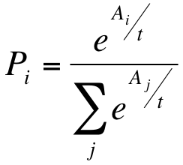
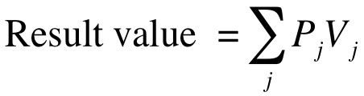
Blending
Each chunk has a probability of being retrieved:
The retrieved interval is a blend of all chunks

Slide 63
How to calculate the blend?
Calculate the activations of all candidate chunks
Apply mismatch penalties to chunks that do not match completely
Example: retrieve a blend for long:
B(short, 9)=2.0
B(short,10)=1.0
B(long,16)=2.0
B(long,17)=1.5
Apply penalty (of -2):
A(short, 9)=0.0
A(short,10)=-1.0
A(long,16)=2.0
A(long,17)=1.5

Slide 64
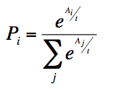
How to calculate the blend?
Now calculate the probability of recall for each of the candidates, using:
Apply penalty:
A(short, 9)=0.0
A(short,10)=-1.0
A(long,16)=2.0
A(long,17)=1.5
Results in (t=1):
p(short, 9)=0.076
p(short, 10)=0.0278
p(long, 16)=0.558
p(long, 17)=0.339

Slide 65
How to calculate the blend?
Multiply each probability with the slot value, and add it all up to get the blended value
Probabilities
p(short, 9)=0.076
p(short, 10)=0.0278
p(long, 16)=0.558
p(long, 17)=0.339
0.076*9 + 0.0278*10 + 0.558* 16 + 0.339 * 17 = 15.65

Slide 66
Handling feedback
In order to handle feedback, the model also stores the feedback on the previous trial in declarative memory
“Too short” is stored as a positive number, “Too long” as a negative number, and “Correct” as 0.
To determine the number of pulses to wait, the model retrieves the duration and the feedback from memory, and adds these together

Slide 67
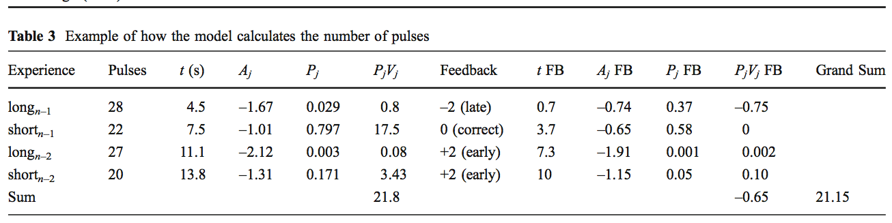

Slide 68
This model produced a good fit
R² | RMSE
0.91 | 229
R² | RMSE
0.82 | 46

Slide 69
Which is better: run the model through the same regression as the data: Short interval
Fixed Effect | β data | β Model
Intercept | 657 ms | 789 ms
short_{n-1} | 0.385 | 0.356
short_{n-2} | 0.085 | 0.048
short-fb-S_{n-1} | 110 ms | 170 ms
short-fb-L_{n-1} | -208 ms | -153 ms
long_{n-1} | 0.16 | 0.15
long-fb-S_{n-1} | 92.6 ms | 125 ms
long-fb-L_{n-1} | -163 ms | -211 ms

Slide 70
And the long interval...
Fixed Effect | β data | β model
Intercept | 695 ms | 493 ms
long_{n-1} | 0.34 | 0.22
long_{n-2} | 0.16 | 0.25
long_{n-3} | 0.12 | 0.12
long_{n-4} | 0.05 | 0.09
long-fb-S_{n-1} | 159 ms | 198 ms
long-fb-L_{n-1} | -118 ms | -251 ms
long-fb-S_{n-2} | 82.9 ms | 90 ms
long-fb-L_{n-2} | 3.8 ms | -57 ms
short_{n-1} | 0.15 | 0.18
short-fb-S_{n-1} | 85 ms | 20 ms
short-fb-L_{n-1} | -107 ms | -35 ms

Slide 71
Model predictions

